Slide 1
Naïve Bayes

Slide 2
Naïve Bayes
Probability basics
Estimating parameters from data
Maximum likelihood (ML)
Maximum a posteriori estimation (MAP)
Naïve Bayes

Slide 3
Contents
Probability basics
Estimating parameters from data
Maximum likelihood (ML)
Maximum a posteriori estimation (MAP)
Naive Bayes

Slide 5
Random Variables
A random variable x takes on a defined set of values with different probabilities.
For example, if you roll a die, the outcome is random (not fixed) and there are 6 possible outcomes, each of which occur with probability one-sixth.
For example, if you poll people about their voting preferences, the percentage of the sample that responds “Yes on Proposition 100” is a also a random variable (the percentage will be slightly differently every time you poll).
Roughly, probability is how frequently we expect different outcomes to occur if we repeat the experiment over and over (“frequentist” view)

Slide 6
Random variables can be discrete or continuous
Discrete random variables have a countable number of outcomes
Examples: Dead/alive, treatment/placebo, dice, counts, etc.
Continuous random variables have an infinite continuum of possible values.
Examples: blood pressure, weight, the speed of a car, the real numbers from 1 to 6.

Slide 7
Probability functions
A probability function maps the possible values of x against their respective probabilities of occurrence, p(x)
p(x) is a number from 0 to 1.0.
The area under a probability function is always 1.
Notes:
It turns out that if you were to go out and sample many, many times, most sample statistics that you could calculate would follow a normal distribution.
What are the 2 parameters (from last time) that define any normal distribution?
Remember that a normal curve is characterized by two parameters, a mean and a variability (SD)
What do you think the mean value of a sample statistic would be? The standard deviation?
Remember standard deviation is natural variability of the population
Standard error can be standard error of the mean or standard error of the odds ratio or standard error of the difference of 2 means, etc. The standard error of any sample statistic.

Slide 8
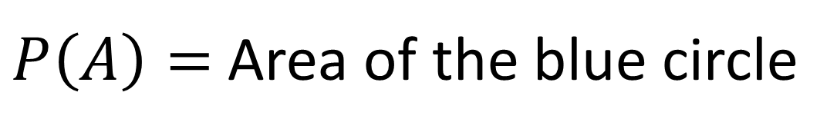

Visualizing probability $P(A)$
Sample space
Area = 1
A is true
A is false
$P\left(A\right)=$Area of the blue circle

Slide 9
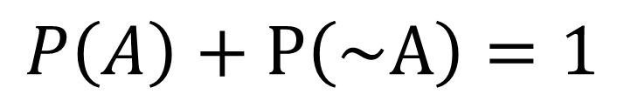
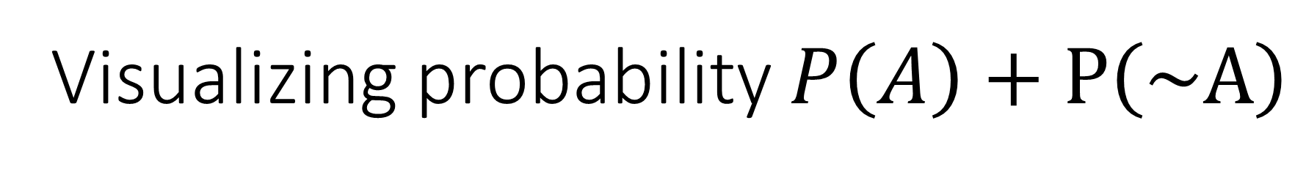
Visualizing probability $P\left(A\right)+P\left(\sim A\right)$
A is true
A is false
$$P\left(A\right)+P\left(\sim A\right)=1$$

Slide 10
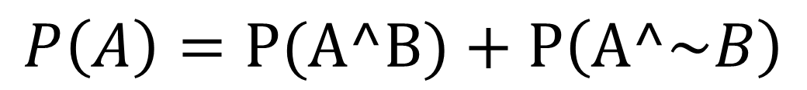

Visualizing probability $P\left(A\right)$
A^B
B
A^~B
$$P\left(A\right)=P(A^B)+P\left(A^\sim B\right)$$

Slide 11

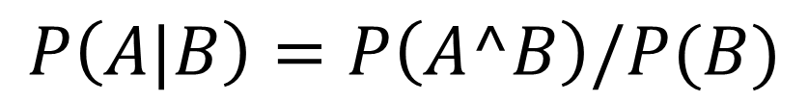
Visualizing conditional probability
A^B
$$P\left(A|B\right)=P\left(A^B\right)/P(B)$$
B
A
Corollary: The chain rule
$$P\left(A, B\right)=P\left(A|B\right)P(B)$$

Slide 12
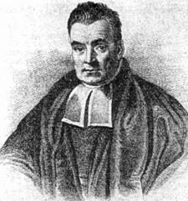
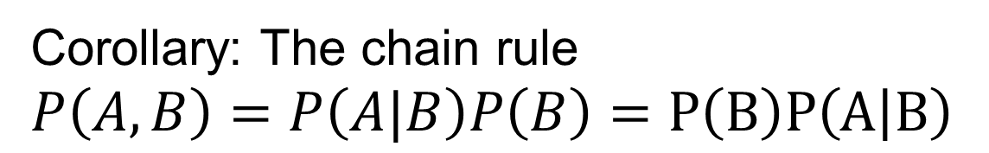

Bayes rule
A^B
B
A
Thomas Bayes
$$P\left(A|B\right)=\frac{P\left(A, B\right)}{P\left(B\right)}$$
$$=\frac{P\left(B | A\right)P\left(A\right)}{P(B)}$$
Corollary: The chain rule $$P\left(A, B\right)=P\left(A|B\right)P\left(B\right)=P\left(B\right)P\left(A | B\right)$$

Slide 13
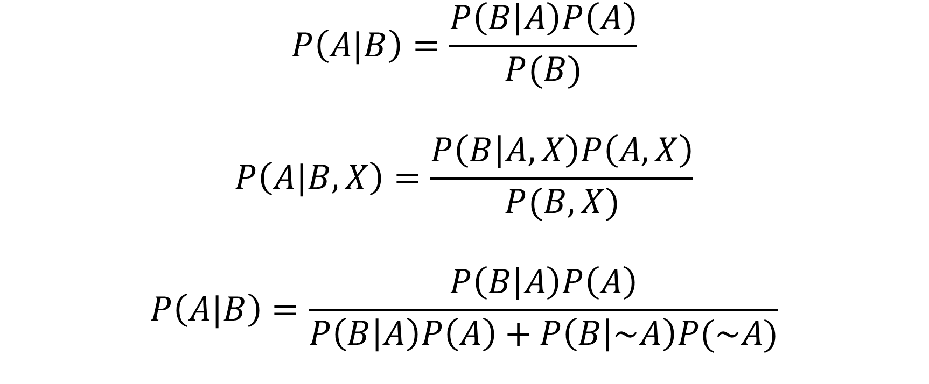
Other forms of Bayes rule
$$P\left(A|B\right)=\frac{P\left(B | A\right)P\left(A\right)}{P(B)}$$
$$P\left(A|B, X\right)=\frac{P\left(B | A,X\right)P\left(A,X\right)}{P(B,X)}$$
$$P\left(A|B\right)=\frac{P\left(B | A\right)P\left(A\right)}{P\left(B | A\right)P\left(A\right)+P\left(B | \sim A\right)P(\sim A)}$$

Slide 14
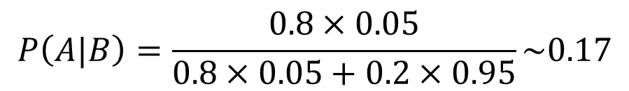
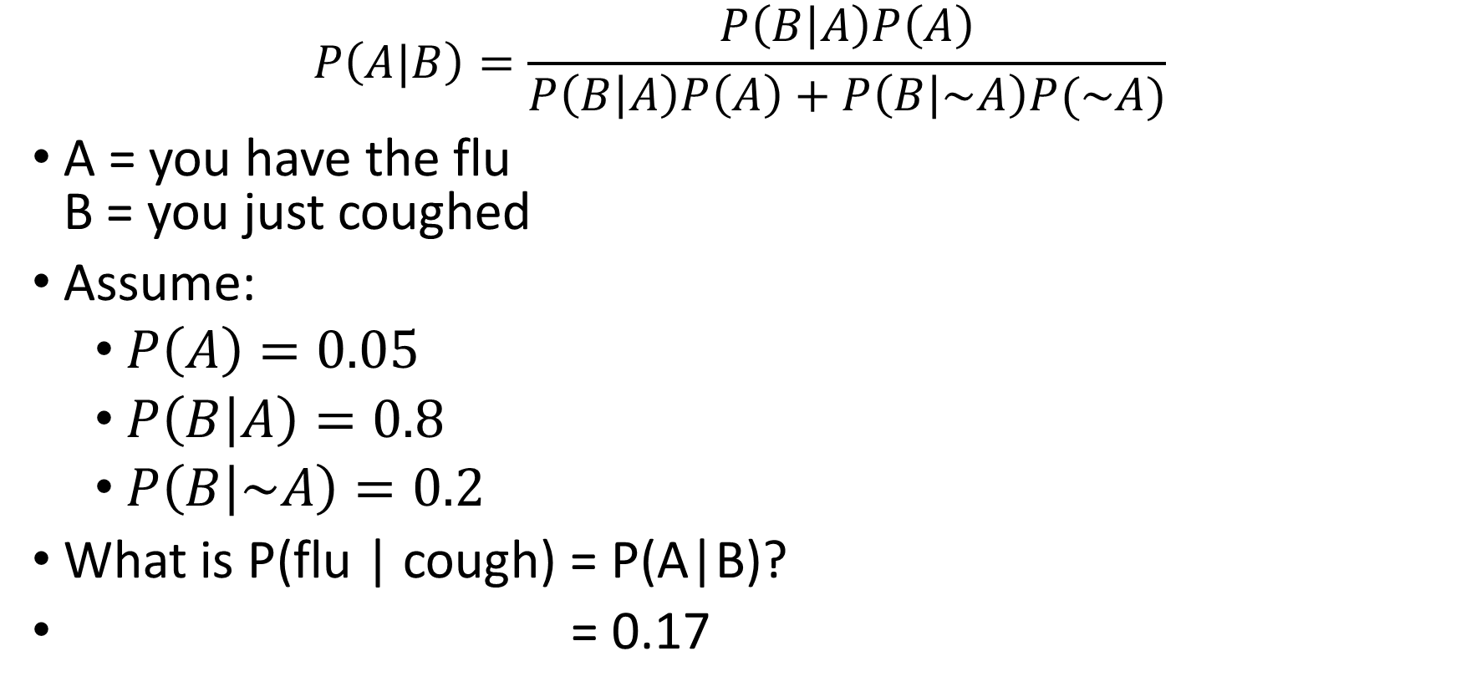
Applying Bayes rule
$$P\left(A|B\right)=\frac{P\left(B | A\right)P\left(A\right)}{P\left(B | A\right)P\left(A\right)+P\left(B | \sim A\right)P(\sim A)}$$
A = you have the flu B = you just coughed
Assume:
$P\left(A\right)=0.05$
$P\left(B | A\right)=0.8$
$P\left(B | \sim A\right)=0.2$
What is P(flu | cough) = P(A|B)?
= 0.17
$$P\left(A|B\right)=\frac{0.8×0.05}{0.8×0.05+0.2×0.95}\sim 0.17$$

Slide 15




Why we are learning this?
Learn $P\left(Y|X\right)$
$$h$$
$$x$$
$$y$$
Hypothesis

Slide 16
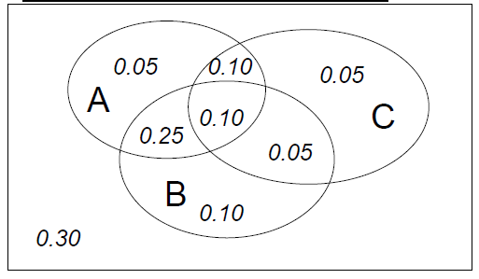
Joint distribution
A | B | C | Prob
0 | 0 | 0 | 0.30
0 | 0 | 1 | 0.05
0 | 1 | 0 | 0.10
0 | 1 | 1 | 0.05
1 | 0 | 0 | 0.05
1 | 0 | 1 | 0.10
1 | 1 | 0 | 0.25
1 | 1 | 1 | 0.10
Making a joint distribution of M variables
Make a truth table listing all combinations
For each combination of values, say how probable it is
Probability must sum to 1

Slide 17
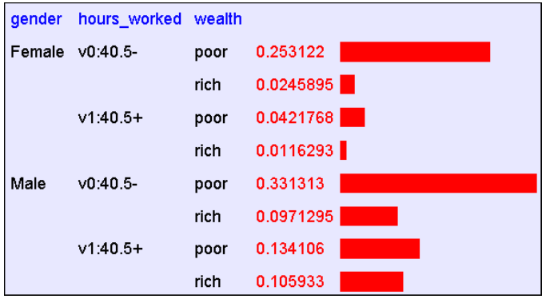
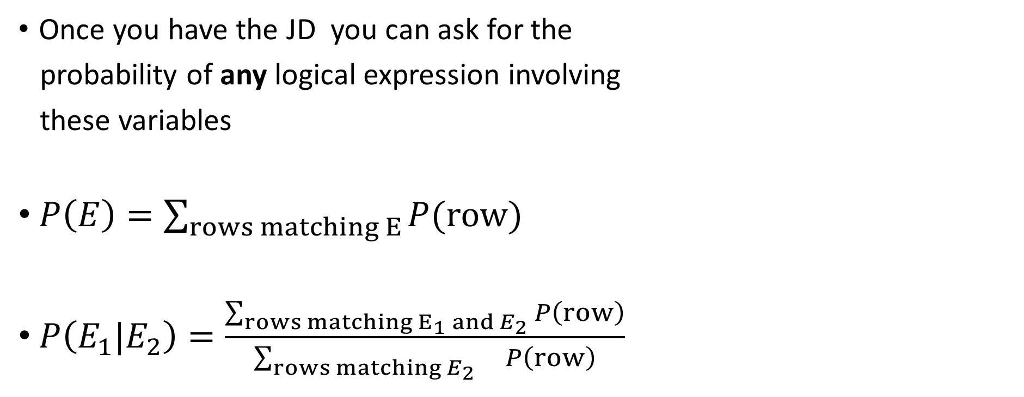
Using joint distribution
Once you have the JD you can ask for the
probability of any logical expression involving
these variables
$P\left(E\right)=\sum_{rows matching E}{P(row)}$
$P\left(E_{1}|E_{2}\right)=\frac{\sum_{rows matching E_{1} and E_{2}}{P\left(row\right)}}{\sum_{rows matching E_{2}}{ P\left(row\right)}}$

Slide 21

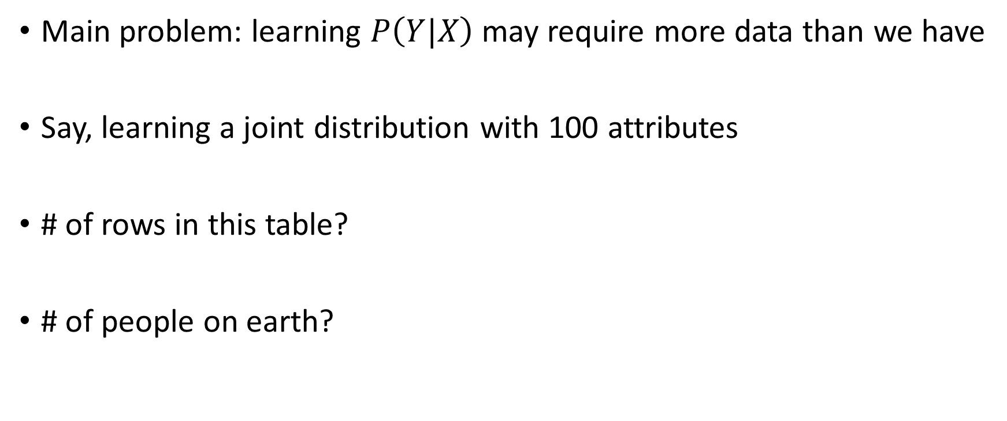



The solution to learn $P\left(Y|X\right)$?
Main problem: learning $P\left(Y|X\right)$ may require more data than we have
Say, learning a joint distribution with 100 attributes
# of rows in this table?
# of people on earth?
$$2^{100}≥{10}^{30}$$
$${10}^{9}$$

Slide 22
What should we do?
Be smart about how we estimate probabilities from sparse data
Maximum likelihood estimates (ML)
Maximum a posteriori estimates (MAP)
Be smart about how to represent joint distributions
Bayes network, graphical models

Slide 23
Probability basics
Estimating parameters from data
Maximum likelihood (ML)
Maximum a posteriori (MAP)
Naive Bayes

Slide 24
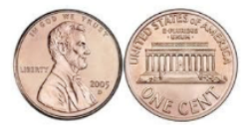
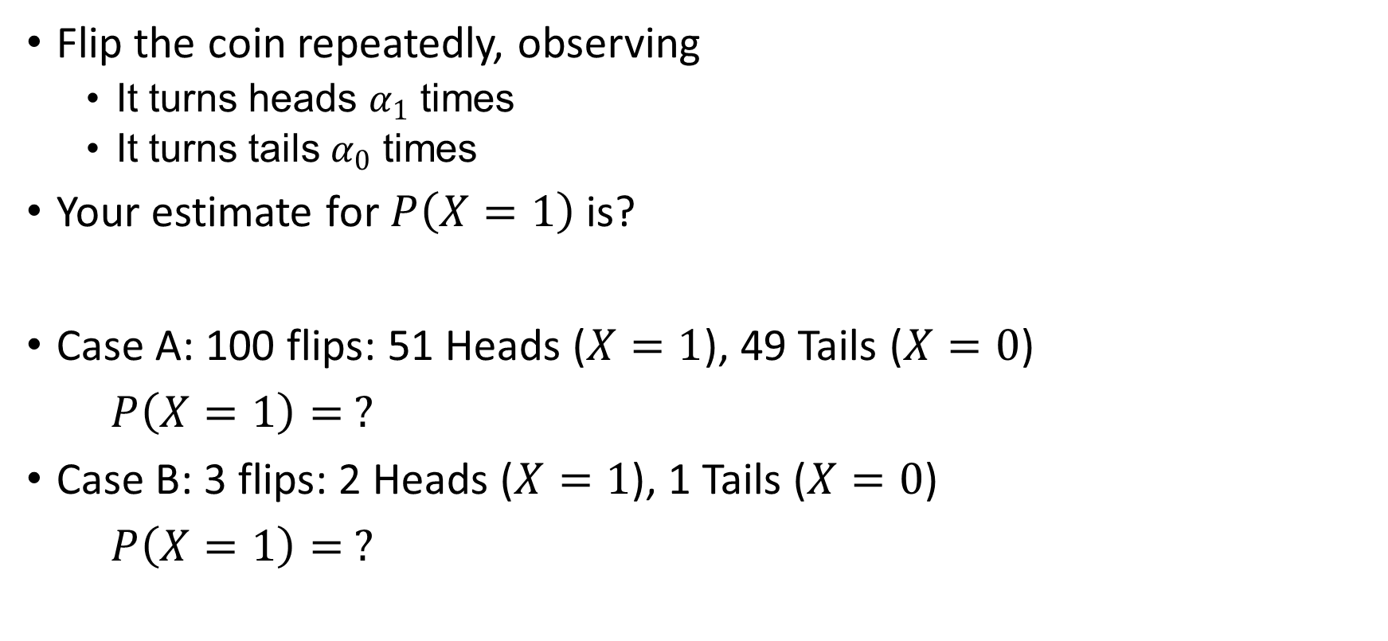
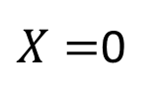

Estimating the probability
$$X=1$$
$X=$0
Flip the coin repeatedly, observing
It turns heads $α_{1}$times
It turns tails $α_{0}$ times
Your estimate for $P\left(X=1\right)$ is?
Case A: 100 flips: 51 Heads ($X=1$), 49 Tails ($X=0$)
$$P\left(X=1\right)= ?$$
Case B: 3 flips: 2 Heads ($X=1$), 1 Tails ($X=0$)
$$P\left(X=1\right)= ?$$

Slide 25
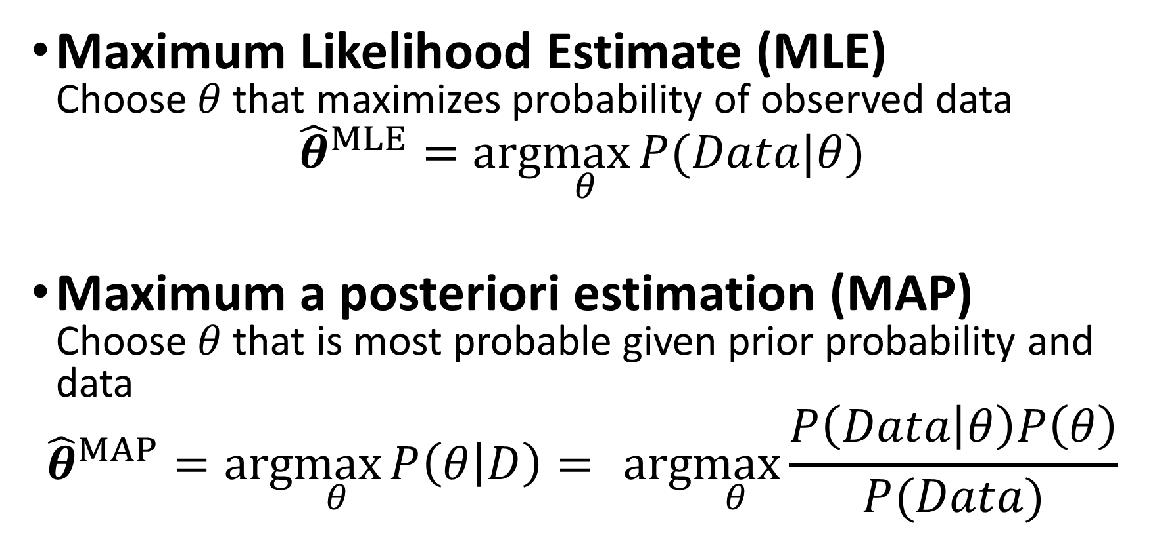
Two principles for estimating parameters
Maximum Likelihood Estimate (MLE) Choose $θ$ that maximizes probability of observed data
$${\hat{θ}}^{MLE}=arg\max_{θ}{P(Data|θ)}$$
Maximum a posteriori estimation (MAP) Choose $θ$that is most probable given prior probability and data
$${\hat{θ}}^{MAP}=arg\max_{θ}{P\left(θ | D\right)= } arg\max_{θ}{\frac{P\left(Data | θ\right)P\left(θ\right)}{P(Data)} }$$

Slide 26
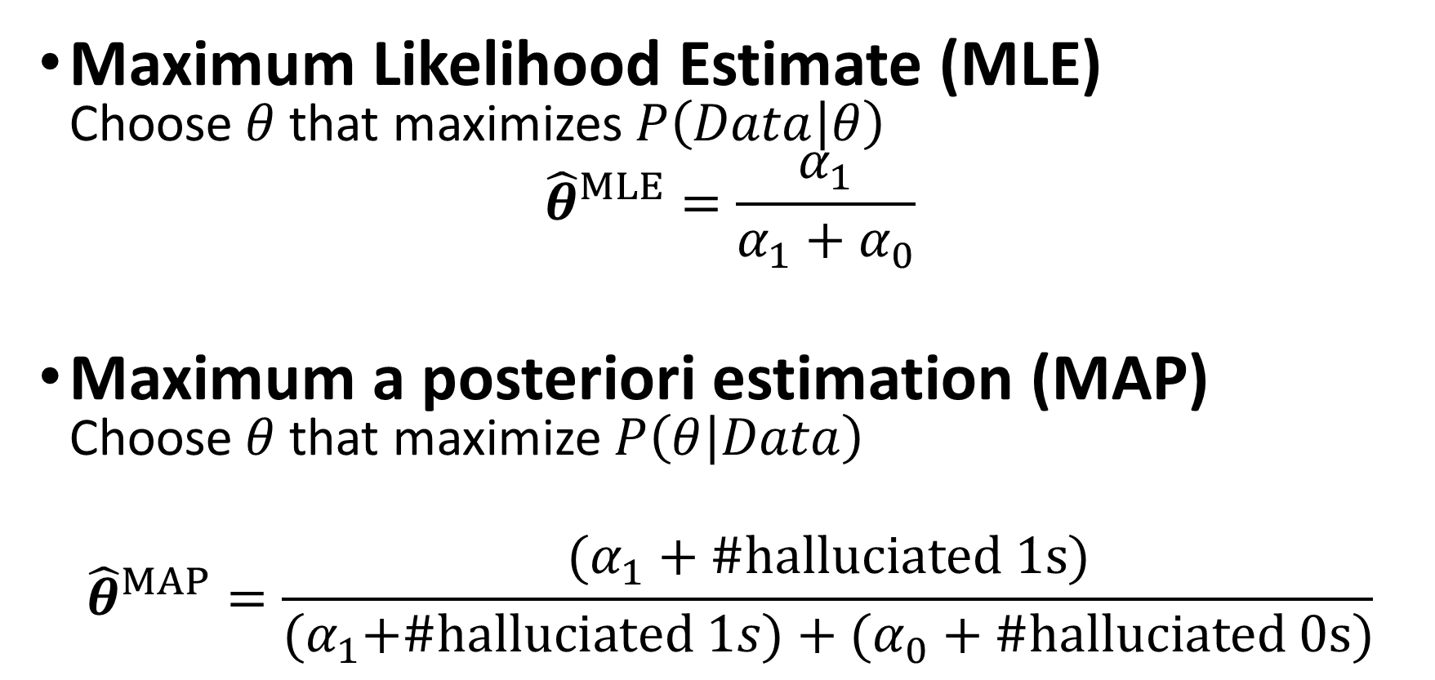
Two principles for estimating parameters
Maximum Likelihood Estimate (MLE) Choose $θ$ that maximizes $P\left(Data | θ\right)$
$${\hat{θ}}^{MLE}=\frac{α_{1}}{α_{1}+α_{0}}$$
Maximum a posteriori estimation (MAP) Choose $θ$that maximize $P\left(θ | Data\right)$
$${\hat{θ}}^{MAP}=\frac{(α_{1}+\#halluciated 1s)}{{(α}_{1}+\#halluciated 1s)+(α_{0}+\#halluciated 0s)}$$

Slide 27
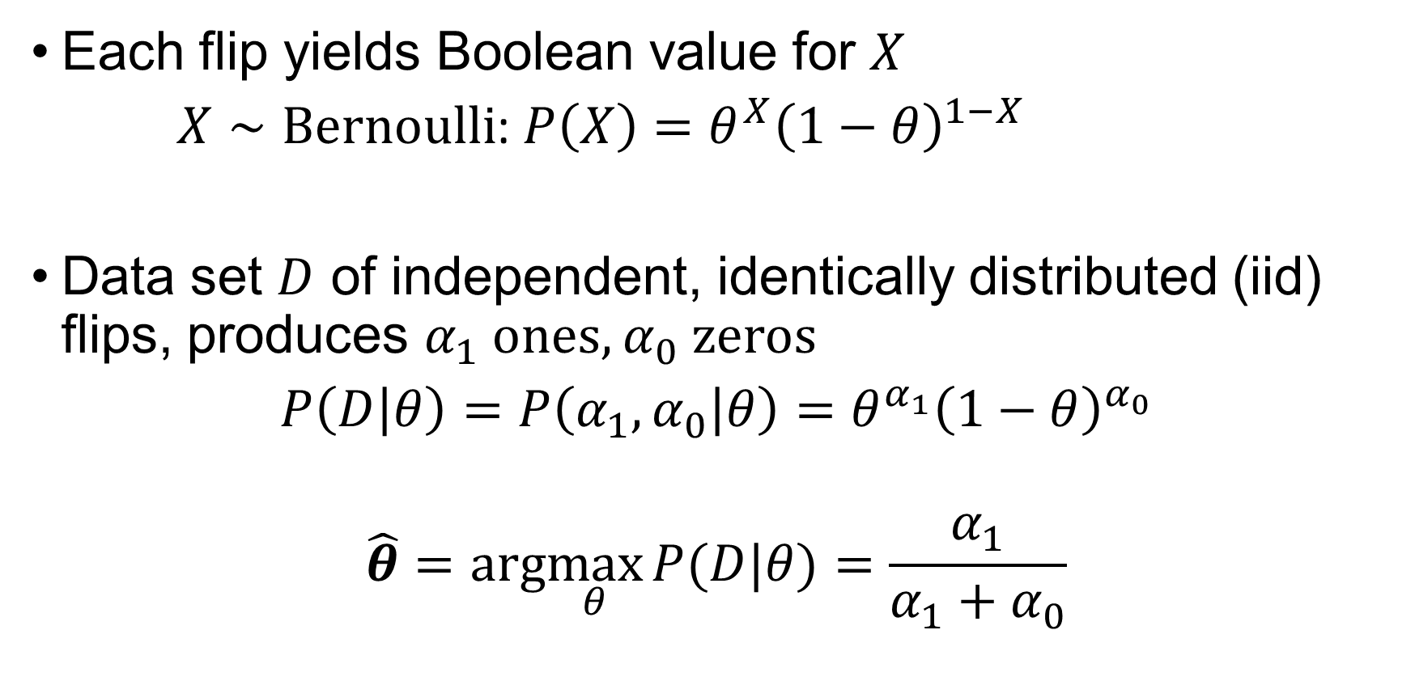
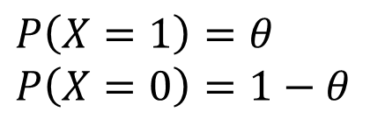
Maximum likelihood estimate
$$X=1$$
$X=$0
Each flip yields Boolean value for $X$
$X∼Bernoulli$: $P\left(X\right)=θ^{X}{\left(1−θ\right)}^{1−X}$
Data set $D$ of independent, identically distributed (iid) flips, produces $α_{1}$ ones, $α_{0}$ zeros
$$P\left(D | θ\right)=P\left(α_{1}, α_{0} | θ\right)=θ^{α_{1}}{\left(1−θ\right)}^{α_{0}}$$
$$\hat{θ}=arg\max_{θ}{P(D|θ)}=\frac{α_{1}}{α_{1}+α_{0}}$$
$$P\left(X=1\right)=θ$$
$$P\left(X=0\right)=1−θ$$

Slide 28
Maximum Likelihood Estimation
Goal : Find the parameter p that maximizes the likelihood of seeing all training samples.
Example: 6H, 4T
P(H) = p, P(T) = 1-p
L(p) = p⁶(1-p)4 ---------→ Find the total likelihood
logL(p) = 6 log(p) + 4 log(1-p) ^{----------- >} Take log likelihood
d(logL(p))/dp = 6/p - 4/(1-p) = 0 ^{---------→} Take derivative
P = 6/10 ^{---------→} Solve

Slide 29
Classification by likelihood1
Suppose we have two classes C₁ and C₂.
Compute the likelihoods P(D|C₁) and P(D|C₂).
To classify test data D’ assign it to class C₁ if P(D|C₁) is greater than P(D|C₂) and C₂ otherwise.

Slide 30
Gaussian models
Assume that class likelihood is represented by a Gaussian distribution with parameters μ (mean) and σ (standard deviation)
We find the model (in other words mean and variance) that maximize the likelihood (or equivalently the log likelihood). Suppose we are given training points x₁,x₂,…,x_{n1} from class C₁. Assuming that each datapoint is drawn independently from C₁ the sample log likelihood is

Slide 31

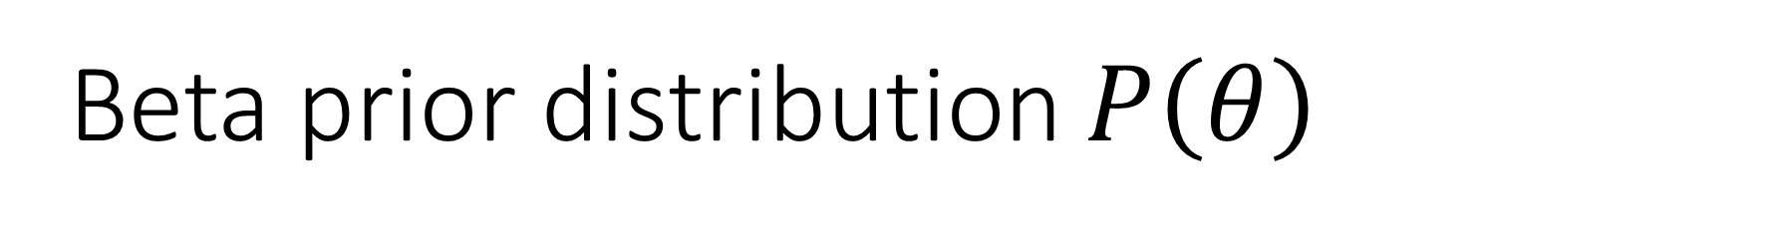
Beta prior distribution $P\left(θ\right)$
$P\left(θ\right)=Beta\left(β_{1}, β_{0}\right)=\frac{1}{B(β_{1}, β_{0})}θ^{β_{1}−1}{\left(1−θ\right)}^{β_{0}−1}$
$β$ makes the probability integrated up to one and a well formed distribution function( a constant and a kind of normalization)

Slide 32
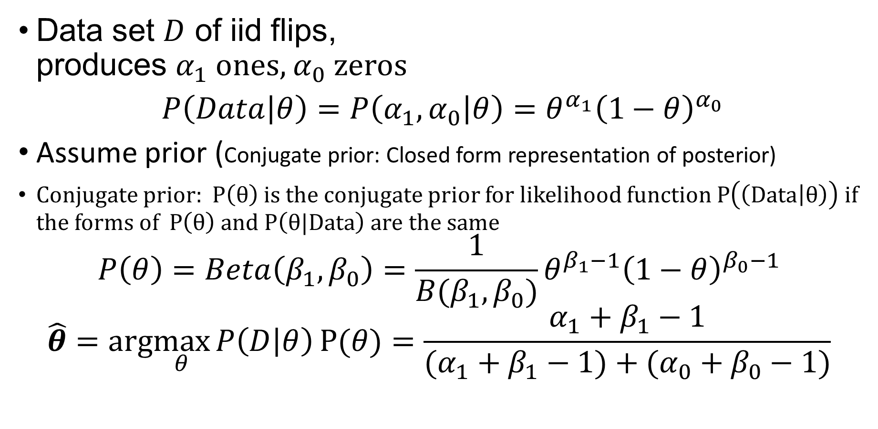
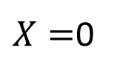

Maximum likelihood estimate
$$X=1$$
$X=$0
Data set $D$ of iid flips, produces $α_{1}$ ones, $α_{0}$ zeros
$$P\left(Data | θ\right)=P\left(α_{1}, α_{0} | θ\right)=θ^{α_{1}}{\left(1−θ\right)}^{α_{0}}$$
Assume prior (Conjugate prior: Closed form representation of posterior)
Conjugate prior: $P\left(θ\right)$ is the conjugate prior for likelihood function $P\left(\left(Data | θ\right)\right)$ if the forms of $P\left(θ\right)$ and $P\left(θ|Data\right)$ are the same
$$P\left(θ\right)=Beta\left(β_{1}, β_{0}\right)=\frac{1}{B(β_{1}, β_{0})}θ^{β_{1}−1}{\left(1−θ\right)}^{β_{0}−1}$$
$$\hat{θ}=arg\max_{θ}{P\left(D | θ\right)}P(θ)=\frac{α_{1}+β_{1}−1}{(α_{1}+β_{1}−1)+(α_{0}+β_{0}−1)}$$

Slide 33
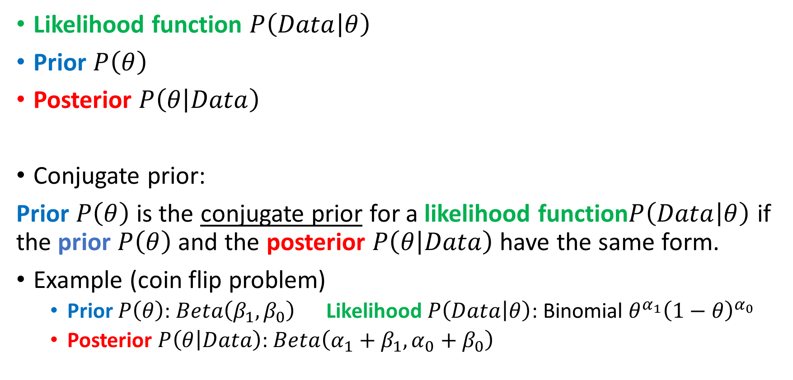
Some terminology
Likelihood function $P\left(Data | θ\right)$
Prior$P\left(θ\right)$
Posterior$P\left(θ | Data\right)$
Conjugate prior:
Prior $P\left(θ\right)$ is the conjugate prior for a likelihoodfunction$P\left(Data | θ\right)$ if the prior$P\left(θ\right)$ and the posterior$P\left(θ | Data\right)$ have the same form.
Example (coin flip problem)
Prior$P\left(θ\right)$: $Beta\left(β_{1}, β_{0}\right)$Likelihood$P\left(Data | θ\right)$: Binomial $θ^{α_{1}}{\left(1−θ\right)}^{α_{0}}$
Posterior$P\left(θ | Data\right)$: $Beta\left({α_{1}+β}_{1}, {α_{0}+β}_{0}\right)$

Slide 34

How many parameters?
Suppose $X=[X_{1},⋯,X_{n}]$, where
$X_{i}$ and $Y$ are Boolean random variables
To estimate $P\left(Y\right|X_{1}, ⋯,X_{n})$
When $n=2$(Gender, Hours-worked)?
When $n=30$?

Slide 35
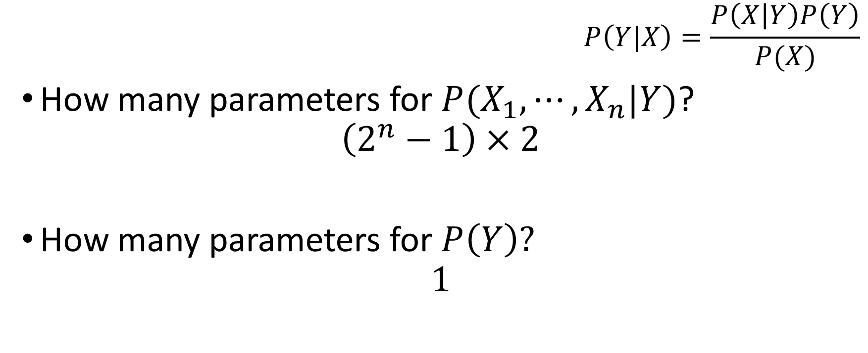
Can we reduce paras using Bayes rule?
$$P\left(Y|X\right)=\frac{P\left(X | Y\right)P\left(Y\right)}{P(X)}$$
How many parameters for $P(X_{1}, ⋯,X_{n}|Y)$?
$$\left(2^{n}−1\right)×2$$
How many parameters for $P\left(Y\right)?$
$$1$$

Slide 36
Contents
Probability basics
Estimating parameters from data
Maximum likelihood (ML)
Maximum a posteriori estimation (MAP)
Naive Bayes

Slide 37
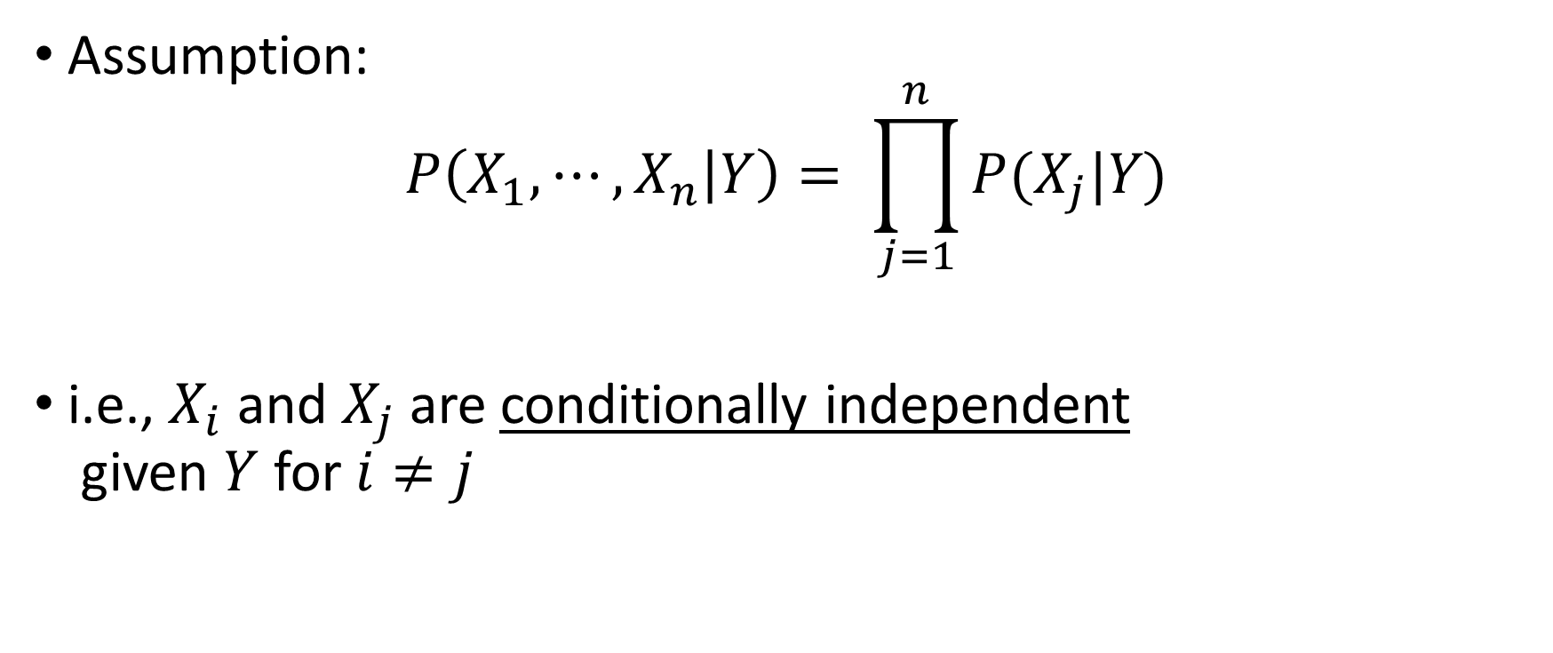
Naïve Bayes
Assumption:
$$P\left(X_{1}, ⋯,X_{n} | Y\right)= \prod_{j=1}^{n}{P(X_{j}|Y)}$$
i.e., $X_{i}$ and $X_{j}$ are conditionally independent given $Y$ for $i≠j$

Slide 38
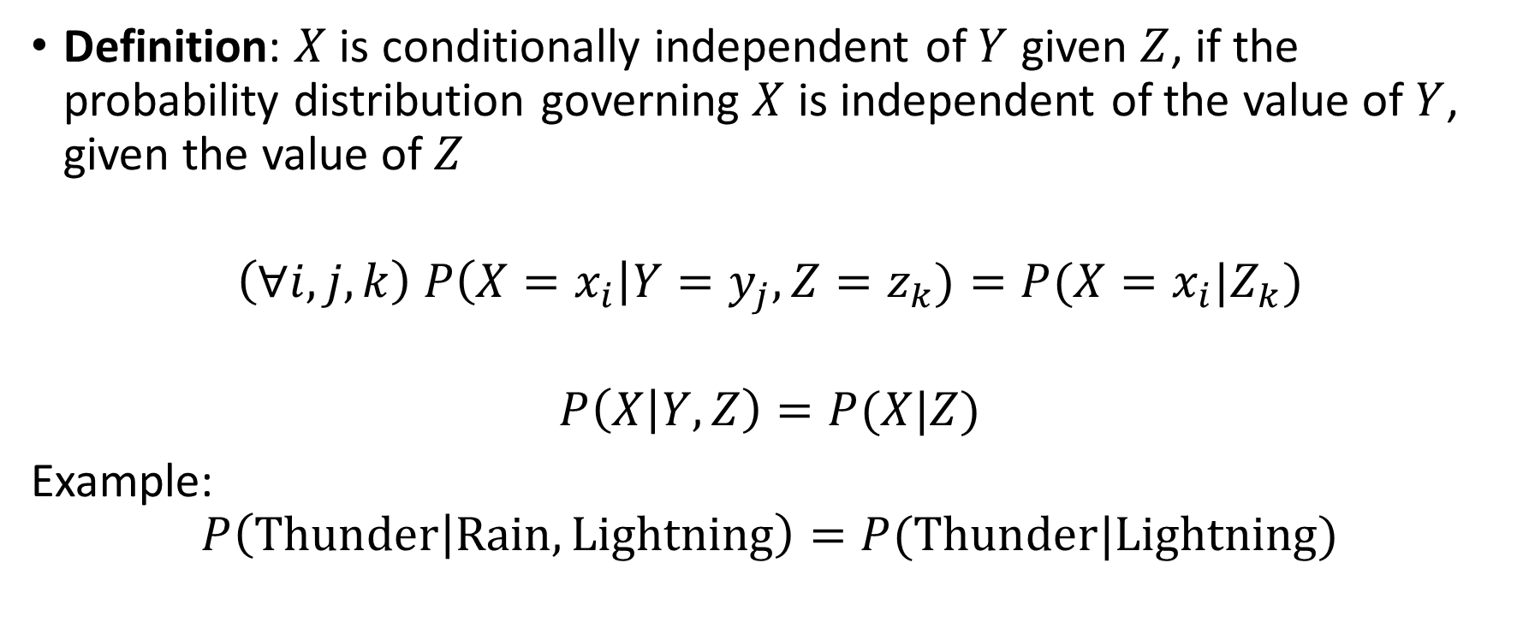
Conditional independence
Definition: $X$ is conditionally independent of $Y$given $Z$, if the probability distribution governing $X$ is independent of the value of $Y$, given the value of $Z$
$$\left(∀i,j,k\right) P\left(X=x_{i}\right|Y=y_{j}, Z=z_{k})=P(X=x_{i}|Z_{k})$$
$$P\left(X | Y, Z\right)=P(X|Z)$$
Example:
$$P\left(Thunder | Rain, Lightning\right)=P(Thunder|Lightning)$$

Slide 39
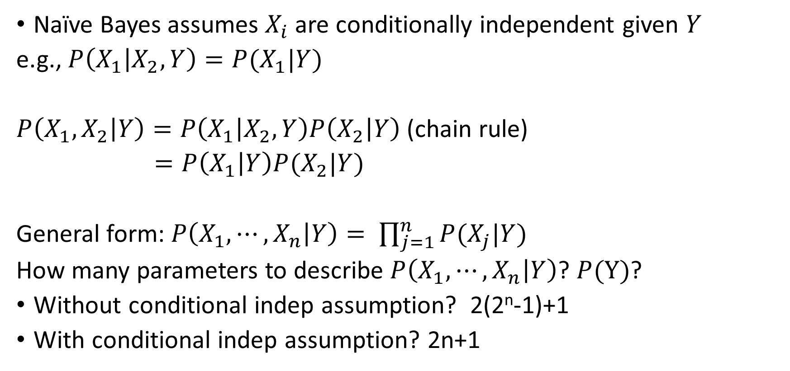
Applying conditional independence
Naïve Bayes assumes $X_{i}$are conditionally independent given $Y$
e.g., $P\left(X_{1} | X_{2}, Y\right)=P(X_{1}|Y)$
$P\left(X_{1}, X_{2} | Y\right)=P\left(X_{1} | X_{2},Y\right)P\left(X_{2} | Y\right)$ (chain rule)
$$=P\left(X_{1} | Y\right)P(X_{2}|Y)$$
General form: $P\left(X_{1}, ⋯,X_{n} | Y\right)= \prod_{j=1}^{n}{P(X_{j}|Y)}$
How many parameters to describe $P\left(X_{1}, ⋯,X_{n} | Y\right)$? $P(Y)$?
Without conditional indep assumption? 2(2^{n}-1)+1
With conditional indep assumption? 2n+1

Slide 40
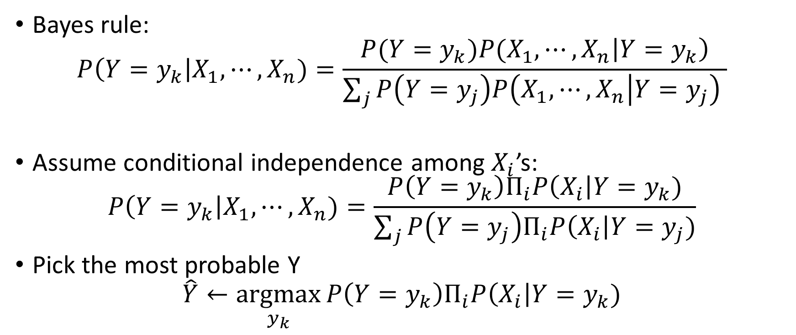
Naïve Bayes classifier
Bayes rule:
$$P\left(Y=y_{k}\right|X_{1}, ⋯,X_{n})=\frac{{P(Y=y_{k})P(X_{1},⋯,X}_{n}\left|Y=y_{k}\right)}{\sum_{j}{P\left(Y=y_{j}\right)P\left(X_{1},⋯, X_{n} | Y=y_{j}\right) }}$$
Assume conditional independence among $X_{i}$’s:
$$P\left(Y=y_{k}\right|X_{1}, ⋯,X_{n})=\frac{P\left(Y=y_{k}\right)Π_{i}P\left(X_{i}\right|Y=y_{k})}{\sum_{j}{P\left(Y=y_{j}\right)Π_{i}P\left(X_{i}\right|Y=y_{j})}}$$
Pick the most probable Y
$$\hat{Y}←\underset{y_{k}}{argmax}{P\left(Y=y_{k}\right)Π_{i}P\left(X_{i}\right|Y=y_{k})}$$

Slide 41
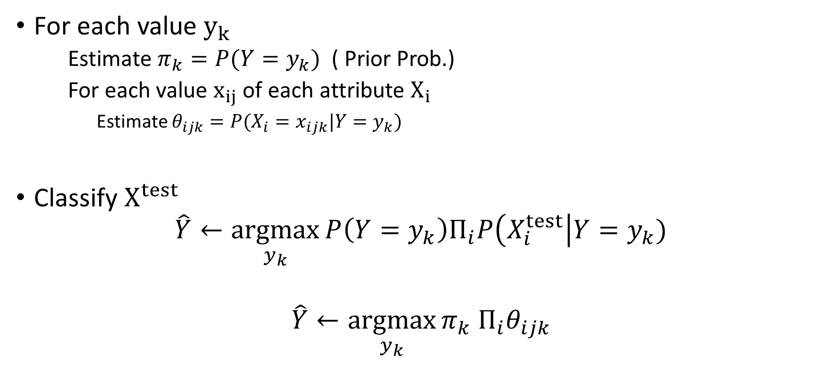
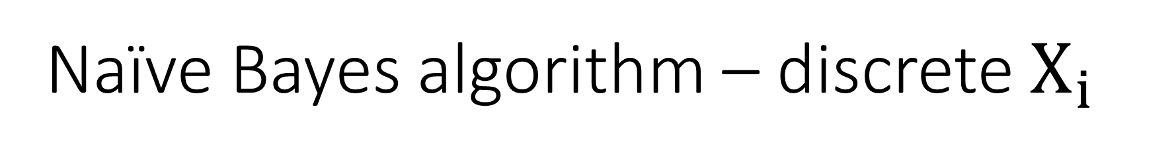
Naïve Bayes algorithm – discrete $X_{i}$
For each value $y_{k}$
Estimate $π_{k}=P(Y=y_{k})$( Prior Prob.)
For each value $x_{ij}$ of each attribute $X_{i}$
Estimate $θ_{ijk}=P(X_{i}=x_{ijk}|Y=y_{k})$
Classify $X^{test}$
$$\hat{Y}←\underset{y_{k}}{argmax}{P\left(Y=y_{k}\right)Π_{i}P\left(X_{i}^{test}\right|Y=y_{k})}$$
$$\hat{Y}←\underset{y_{k}}{argmax}{π_{k} Π_{i}θ_{ijk}}$$

Slide 42
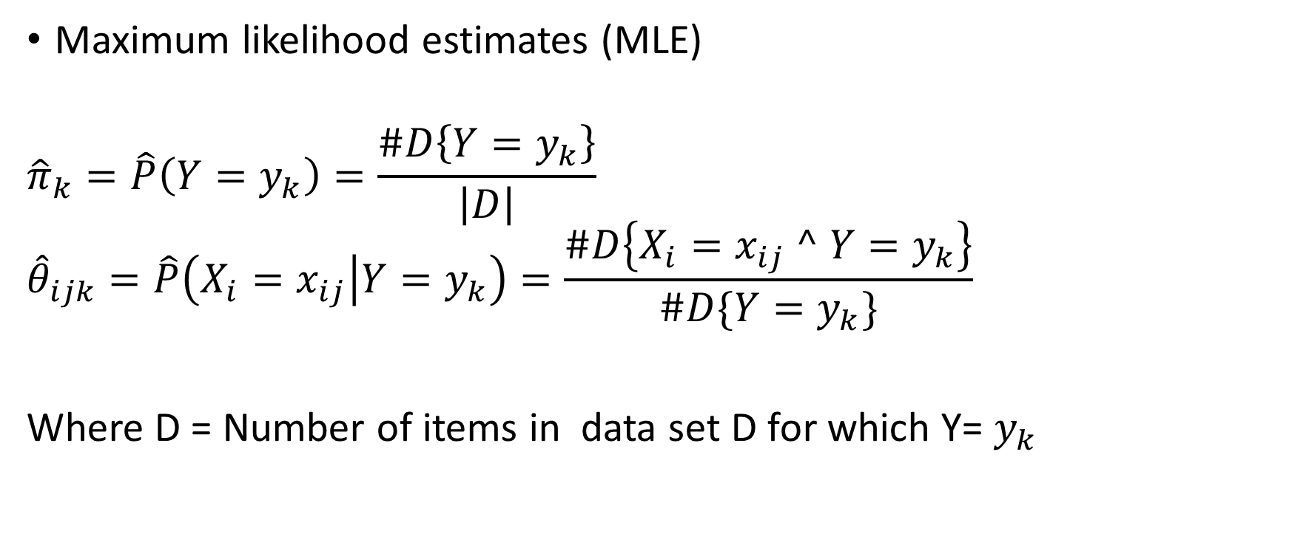
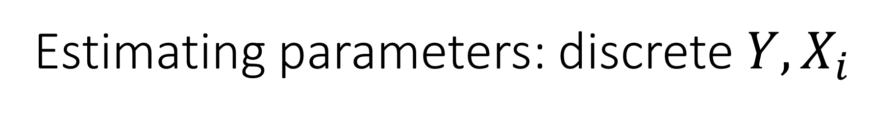
Estimating parameters: discrete $Y, X_{i}$
Maximum likelihood estimates (MLE)
$${\hat{π}}_{k}=\hat{P}\left(Y=y_{k}\right)=\frac{\#D\left\{Y=y_{k}\right\}}{\left|D\right|}$$
$${\hat{θ}}_{ijk}=\hat{P}\left(X_{i}=x_{ij} | Y=y_{k}\right)=\frac{\#D\left\{X_{i}=x_{ij} ^ Y=y_{k}\right\}}{\#D\{Y=y_{k}\}}$$
Where D = Number of items in data set D for which Y= $y_{k}$

Slide 43
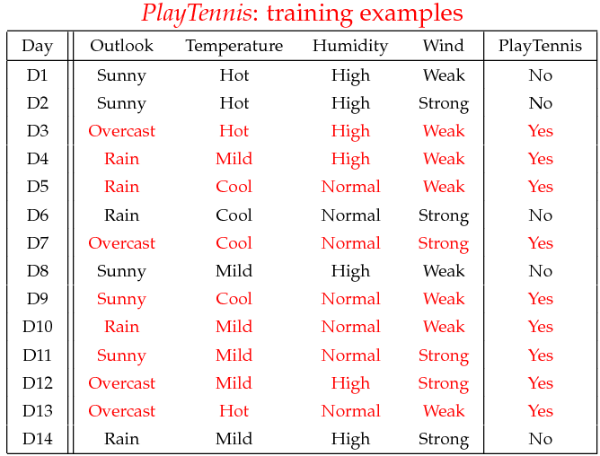
Example
Example: Play Tennis

Slide 45
Example
Learning Phase
Outlook | Play=Yes | Play=No
Sunny | 2/9 | 3/5
Overcast | 4/9 | 0/5
Rain | 3/9 | 2/5
Temperature | Play=Yes | Play=No
Hot | 2/9 | 2/5
Mild | 4/9 | 2/5
Cool | 3/9 | 1/5
Humidity | Play=Yes | Play=No
High | 3/9 | 4/5
Normal | 6/9 | 1/5
Wind | Play=Yes | Play=No
Strong | 3/9 | 3/5
Weak | 6/9 | 2/5
P(Play=Yes) = 9/14
P(Play=No) = 5/14

Slide 46
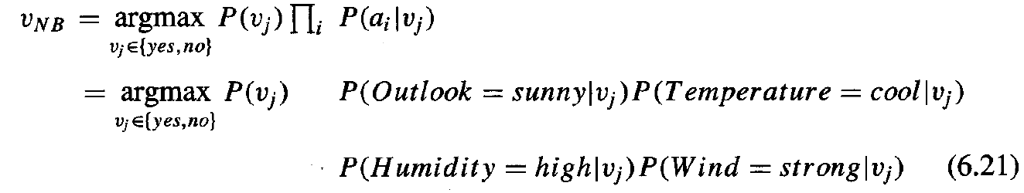
Example
Test Phase
Given a new instance,
vj=(Outlook=Sunny, Temperature=Cool, Humidity=High, Wind=Strong)
Look up tables
MAP rule
P(Outlook=Sunny|Play=Yes) = 2/9
P(Temperature=Cool|Play=Yes) = 3/9
P(Huminity=High|Play=Yes) = 3/9
P(Wind=Strong|Play=Yes) = 3/9
P(Play=Yes) = 9/14
P(Outlook=Sunny|Play=No) = 3/5
P(Temperature=Cool|Play==No) = 1/5
P(Huminity=High|Play=No) = 4/5
P(Wind=Strong|Play=No) = 3/5
P(Play=No) = 5/14
P(Yes| vj): [P(Sunny|Yes)P(Cool|Yes)P(High|Yes)P(Strong|Yes)]P(Play=Yes) = 0.0053
P(No|vj): [P(Sunny|No) P(Cool|No)P(High|No)P(Strong|No)]P(Play=No) = 0.0206
Given the fact P(Yes|vj) < P(No| vj), we label vj to be “No”.

Slide 47
How to classify the new record X = (Refund=‘Yes’, Status = ‘Single’, Taxable Income =80K)

Slide 48
Example of Naïve Bayes Classifier
Given a Test Record:
X = (Refund = Yes, Status = Single, Income =80K)
P(X|Class=No) = P(Refund=Yes|Class=No) × P(Married| Class=No) × P(Income=120K| Class=No) = 3/7 * 2/7 * 0.0062 = 0.00075
P(X|Class=Yes) = P(Refund=No| Class=Yes) × P(Married| Class=Yes) × P(Income=120K| Class=Yes) = 0 * 2/3 * 0.01 = 0
P(No) = 0.3, P(Yes) = 0.7
Since P(X|No)P(No) > P(X|Yes)P(Yes)
Therefore P(No|X) > P(Yes|X) => Class = No

Slide 49
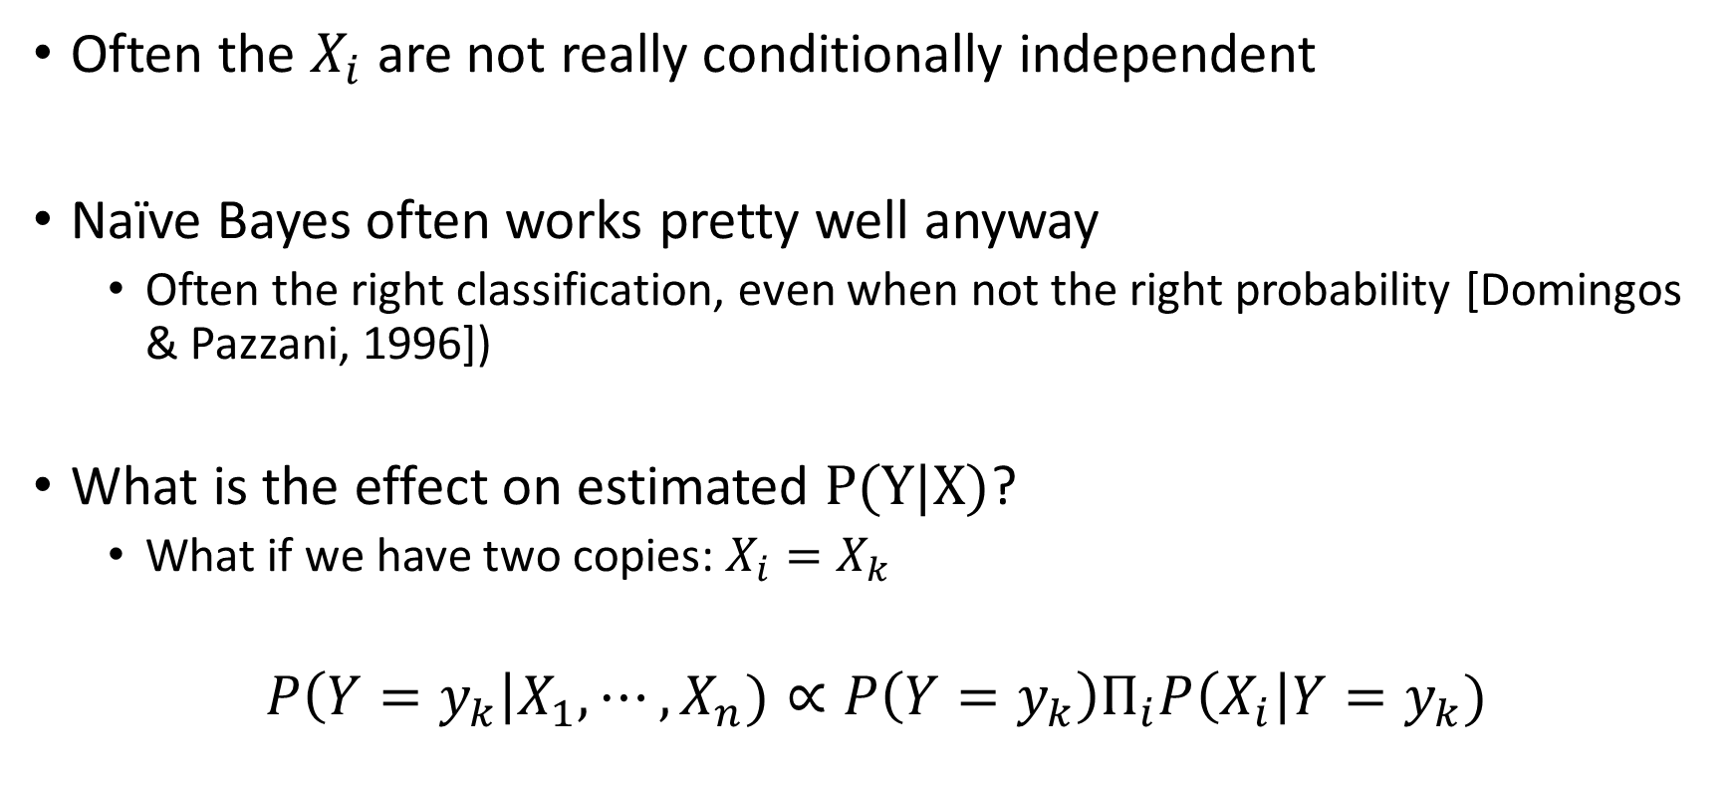
Naïve Bayes: Subtlety #1
Often the $X_{i}$ are not really conditionally independent
Naïve Bayes often works pretty well anyway
Often the right classification, even when not the right probability [Domingos&Pazzani, 1996])
What is the effect on estimated $P(Y|X)$?
What if we have two copies: $X_{i}=X_{k}$
$$P\left(Y=y_{k}\right|X_{1}, ⋯,X_{n})∝P\left(Y=y_{k}\right)Π_{i}P\left(X_{i}\right|Y=y_{k})$$

Slide 50
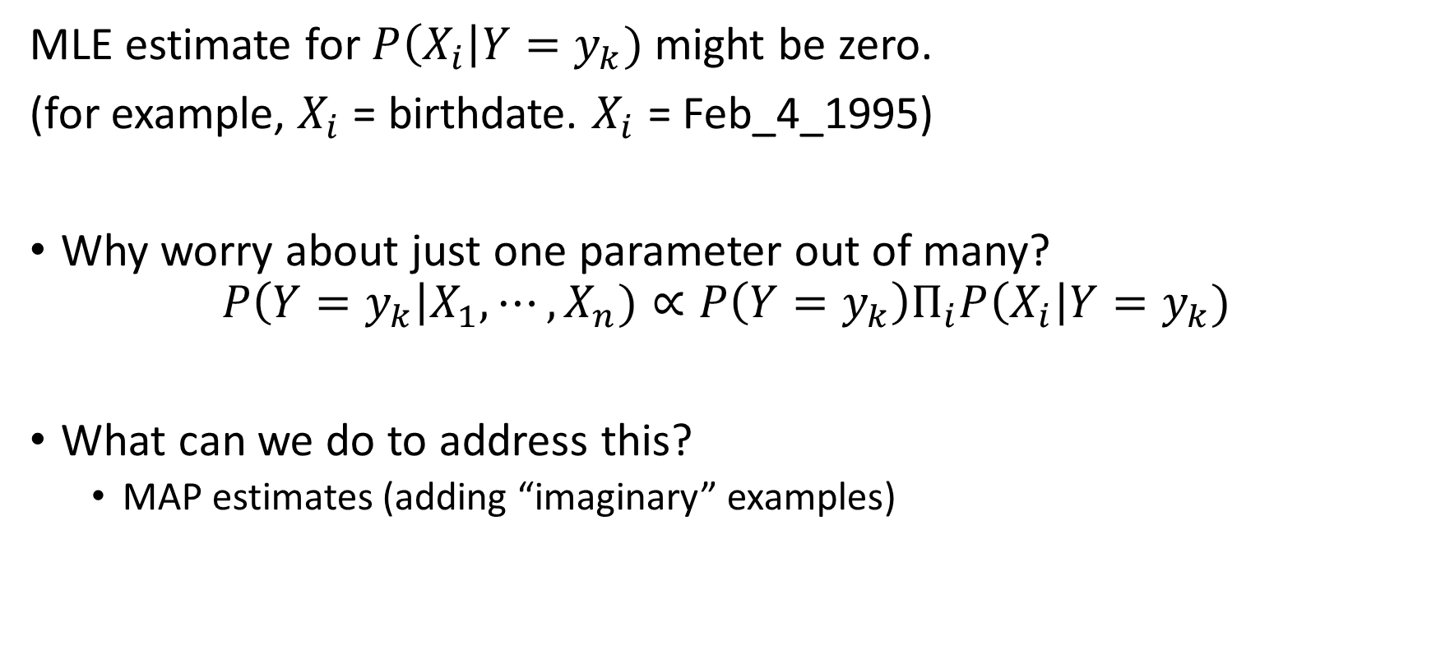
Naïve Bayes: Subtlety #2
MLE estimate for $P\left(X_{i}\right|Y=y_{k})$ might be zero.
(for example, $X_{i}$ = birthdate. $X_{i}$ = Feb_4_1995)
Why worry about just one parameter out of many?
$$P\left(Y=y_{k}\right|X_{1}, ⋯,X_{n})∝P\left(Y=y_{k}\right)Π_{i}P\left(X_{i}\right|Y=y_{k})$$
What can we do to address this?
MAP estimates (adding “imaginary” examples)

Slide 51
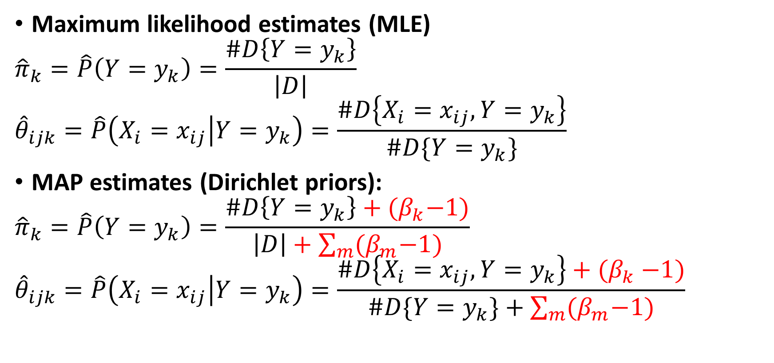
Estimating parameters: discrete $Y, X_{i}$
Maximum likelihood estimates (MLE)
$${\hat{π}}_{k}=\hat{P}\left(Y=y_{k}\right)=\frac{\#D\left\{Y=y_{k}\right\}}{\left|D\right|}$$
$${\hat{θ}}_{ijk}=\hat{P}\left(X_{i}=x_{ij} | Y=y_{k}\right)=\frac{\#D\left\{X_{i}=x_{ij}, Y=y_{k}\right\}}{\#D\{Y=y_{k}\}}$$
MAP estimates (Dirichlet priors):
$${\hat{π}}_{k}=\hat{P}\left(Y=y_{k}\right)=\frac{\#D\left\{Y=y_{k}\right\}+{(β}_{k}−1)}{\left|D\right|+\sum_{m}{{(β}_{m}−1)}}$$
$${\hat{θ}}_{ijk}=\hat{P}\left(X_{i}=x_{ij} | Y=y_{k}\right)=\frac{\#D\left\{X_{i}=x_{ij}, Y=y_{k}\right\}{+ (β}_{k}−1)}{\#D\{Y=y_{k}\}+\sum_{m}{{(β}_{m}−1)}}$$

Slide 52
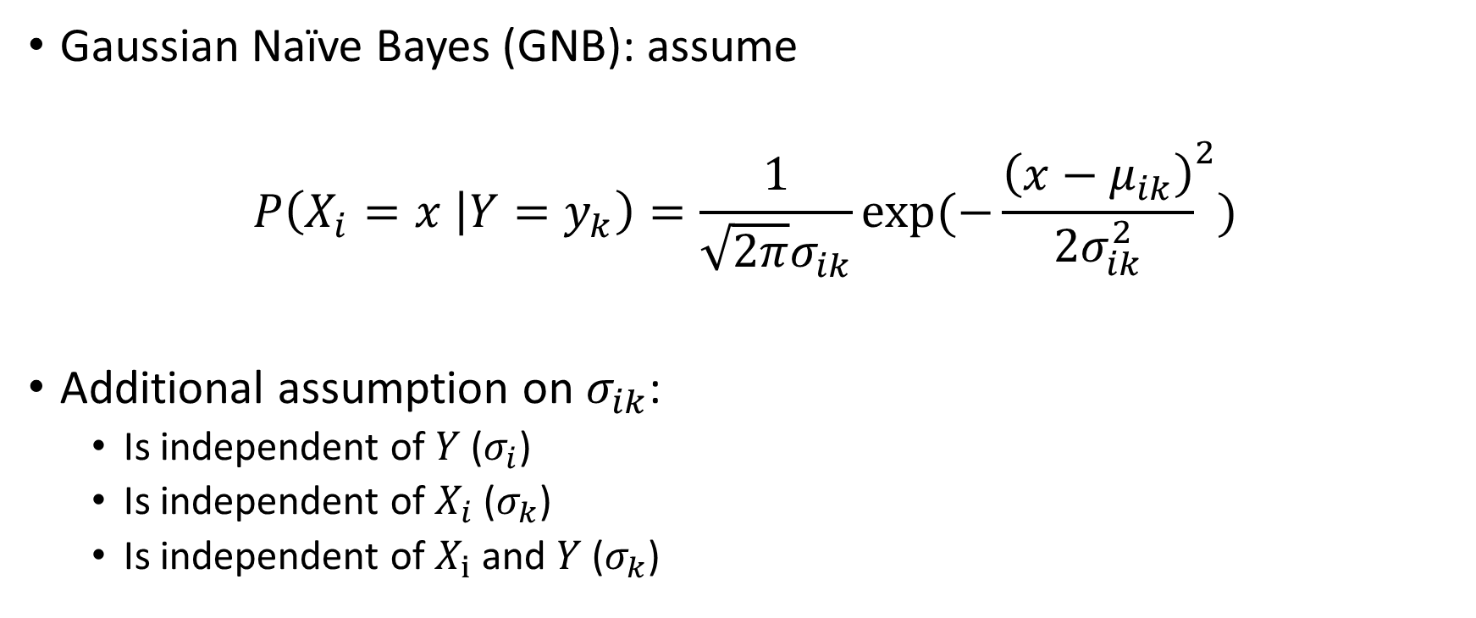

What if we have continuous $X_{i}$
Gaussian Naïve Bayes (GNB): assume
$$P\left(X_{i}=x | Y=y_{k}\right)=\frac{1}{\sqrt{2π}σ_{ik}}exp⁡({−\frac{\left(x−μ_{ik}\right)}{2σ_{ik}^{2}}}^{2})$$
Additional assumption on $σ_{ik}$:
Is independent of $Y$ ($σ_{i}$)
Is independent of $X_{i}$ ($σ_{k}$)
Is independent of $X_{i}$ and $Y$($σ_{k}$)

Slide 53
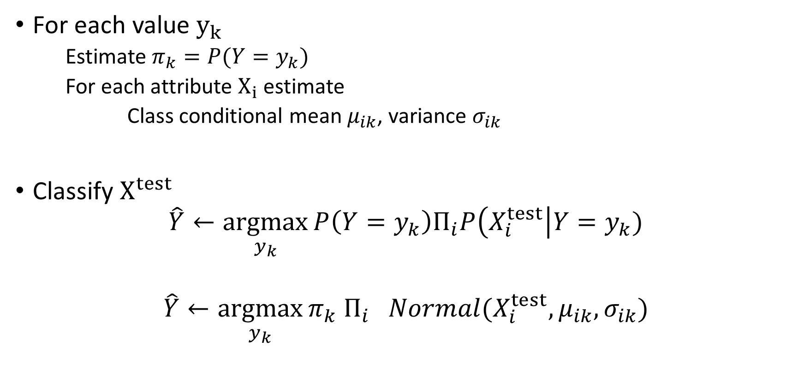
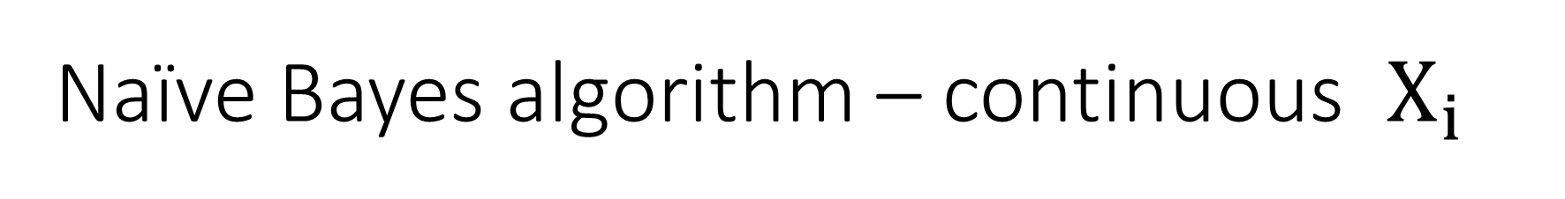
Naïve Bayes algorithm – continuous $X_{i}$
For each value $y_{k}$
Estimate $π_{k}=P(Y=y_{k})$
For each attribute $X_{i}$ estimate
Class conditional mean $μ_{ik}$, variance $σ_{ik}$
Classify $X^{test}$
$$\hat{Y}←\underset{y_{k}}{argmax}{P\left(Y=y_{k}\right)Π_{i}P\left(X_{i}^{test}\right|Y=y_{k})}$$
$$\hat{Y}←\underset{y_{k}}{argmax}{π_{k} Π_{i} Normal(X_{i}^{test},μ_{ik},σ_{ik})}$$

Slide 54

Things to remember
Probability basics
Estimating parameters from data
Maximum likelihood (ML) maximize $P(Data|θ)$
Maximum a posteriori estimation (MAP) maximize $P(θ|Data)$
Naive Bayes
$$P\left(Y=y_{k}\right|X_{1}, ⋯,X_{n})∝P\left(Y=y_{k}\right)Π_{i}P\left(X_{i}\right|Y=y_{k})$$

